Slide 1
How Much is a Data Science Job Candidate Worth?
By Laura Gascue

Slide 2
Diversity in the DS/ML Field
Experienced data scientists coexist with a large number of recent graduates
Large number of tools requiring diverse skills:
Data visualization libraries,
ML Frameworks and algorithms,
computer vision methods,
natural language processing (NLP)
Multiple programming languages
Python, R, C/C++, Java/Javascript, Julia, Swift, etc.
Data Scientists and related positions:
Data Scientist, Data Engineer, DBA/Database Engineer, Research Scientist, Machine Learning Engineer, Statistician, Business Analyst, Data Analyst

Slide 3
Data Sources
Kaggle 2021 Data Science and Machine Learning (DS & ML) Survey
Distributed to the entire Kaggle community through e-mail, promoted via website and Twitter
Objective: picture of the state of the DS & ML field around the world
Question on yearly compensation, demographic characteristics, experience, skills and place of work
Supplemental sources
World Population Review
BLS - Occupational Employment and Wage Statistics

Slide 4
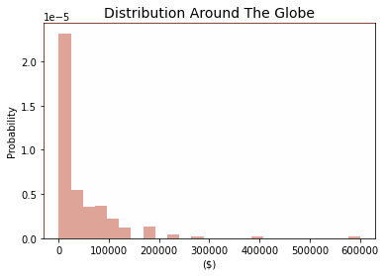
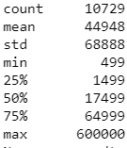
DS/ML Community - Salary Distribution
Occupation (SOC code) | Annual mean wage
Database Administrators and Architects(151245) | 101,090
Software Developers and Software Quality Assurance Analysts and Testers(151256) | 114,270
Mathematical Science Occupations(152000) | 99,700
Operations Research Analysts(152031) | 92,280
Statisticians(152041) | 97,170
Data Scientists and Mathematical Science Occupations, All Other(152098) | 103,930

Slide 5
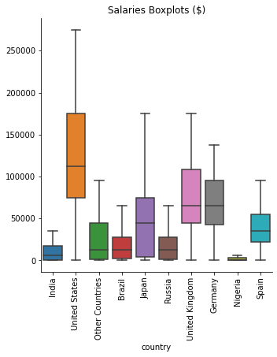
Distribution by Country - Top Respondents
Large disparities between countries
Large variation within countries

Slide 6
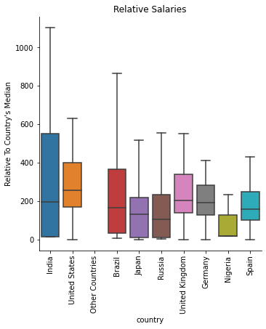
Distribution Relative to Country’s Median Household Income
Disparities less pronounced
Still large variation within countries
Salaries in the DS/ML community largely above country median

Slide 7
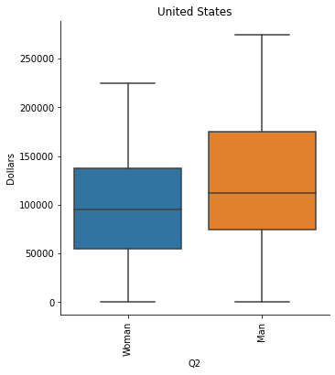
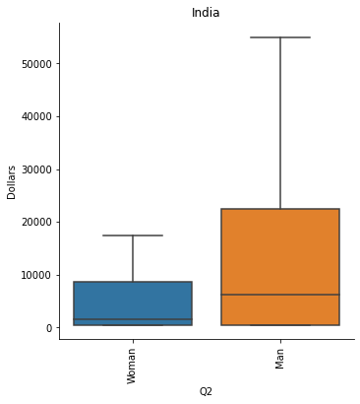
Gender Disparities
Large salary gap between men and women ($46K vs $33K, average around the world)
Gap present in US and India (top respondents, high and low end of income level)
US: $126K vs $97K
India: $21K vs 7K

Slide 8
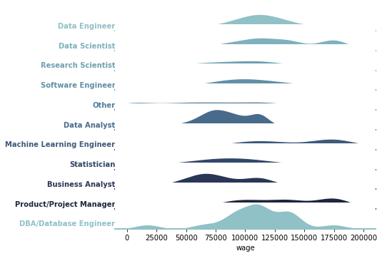
United States Salaries - By Job Title

Slide 9
Conclusion
Salaries in the DS/ML community vary by country of residence, gender, experience and position title
After considering these aspects there is still much variation in salaries
Other factors may be relevant to predict salaries

